Slide 1
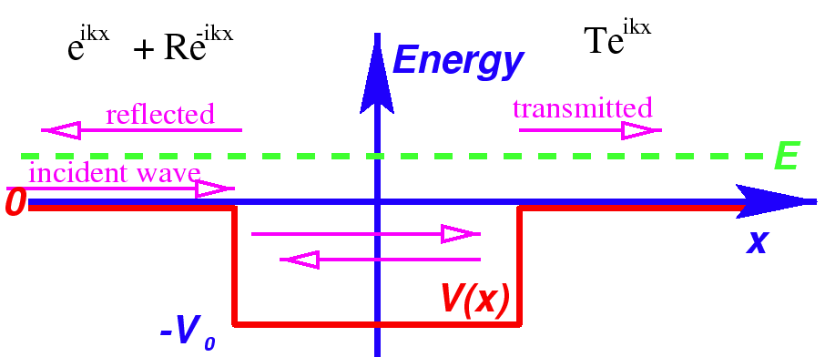
Scattering From a Finite Potential Well
$${Ψ_{I}\left(x,t\right)=Ae}^{ik\left(x−ωt\right)}+Be^{−ik\left(x+ωt\right)}$$
$${Ψ_{Transmitted}\left(x,t\right)=Fe}^{ik\left(x−ωt\right)}$$
$$a$$
$$−a$$

Slide 2
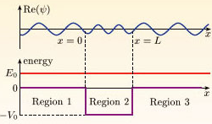
Scattering From a Finite Potential Well
Particle speeds up over the well
https://www.open.edu/openlearn/science-maths-technology/science/physics-and-astronomy/scattering-and-tunnelling/content-section-3.5

Slide 3
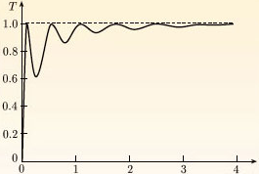
Transmission Probability vs. Incident Particle Energy
$$T={\left|F/A\right|}^{2}$$
$$E/V_{0}$$
Parameters used:
m = mass of electron
V₀ = 8.6 eV
2a = 1 nm
Perfect transmission resonances at $\sin\left(nπ\right)$
which corresponds to:
$$E+V_{0}=\frac{{n^{2}π}^{2}ℏ^{2}}{2m{\left(2a\right)}^{2}}$$
$$\text{with} n=1, 2, 3,…$$
https://www.open.edu/openlearn/science-maths-technology/science/physics-and-astronomy/scattering-and-tunnelling/content-section-3.5

